Slide 1
Cheviot Primary School and SEND Outreach Service
Communication and Interaction Specialist Teacher Support

Slide 2
Nature of need
The social Communication Team have been involved with a number of our children within Y5, Y4 and predominantly Y1.
The Y1 class currently has 6 children who are diagnosed with autism, 3 of which have an EHCP and a further 3 children within the class are on the pathway to be assessed by CYPS – there is a very high level of need within the class.

Slide 3
Outline of support
Support was provided from the onset when children joined Cheviot; David McLeod shared information about the new starters ahead of the children starting in Reception.
Support has been ongoing from David and Christie Johnson ever since through observations, recommendations, emails and telephone conversations.

Slide 4
CPD
Staff attended the ATE Autism awareness training delivered by David McLeod during the summer term of 2021.

Slide 5
Request for support
The aim of the support was to ensure the children learnt to:
Transition into Cheviot then from Reception to Y1
Ensure children’s anxieties were maintained and reduced
Staff were using all the strategies to support the children and meet their individual needs
Coped with the demands of a mainstream classroom
Learning activities were differentiated appropriately

Slide 6
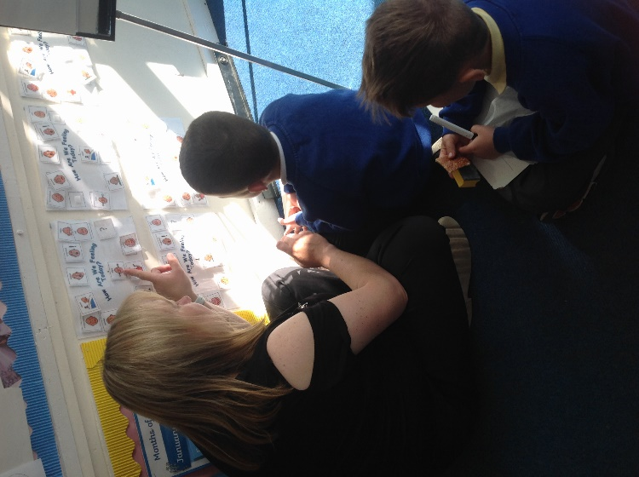
Recommendations :
Emotional work: 'how am I feeling today?'
Pupils have their own emotional board
Emotions are labelled and taught
Each day the children pick a symbol to say how they feel
This is regularly visited as the child presents with different emotions

Slide 7
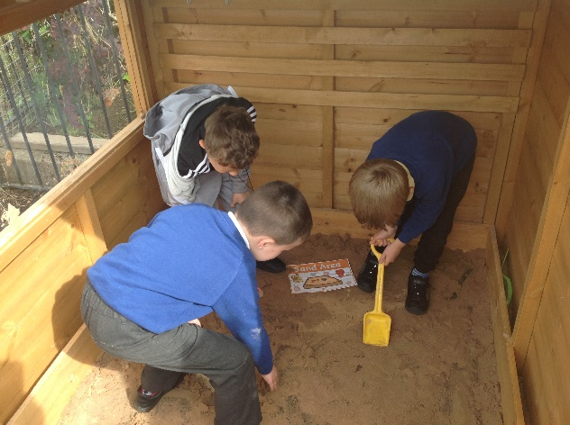
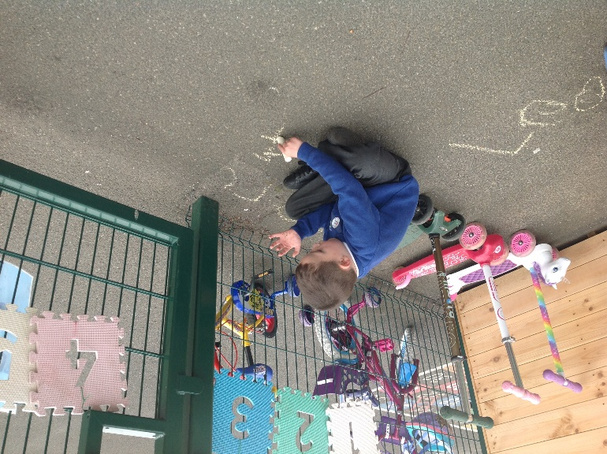
Accessing a quiet/calming area
Accessing learning breaks outside

Slide 8
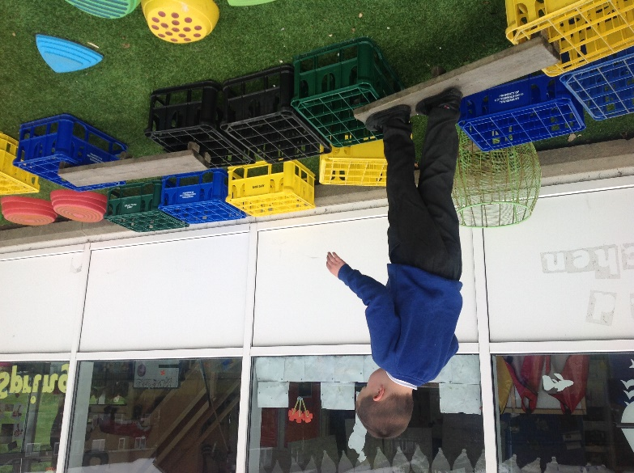
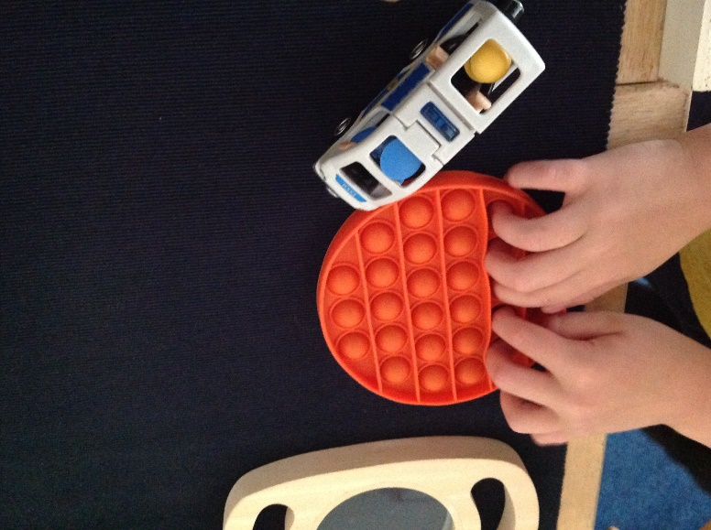
Calming activities

Slide 9
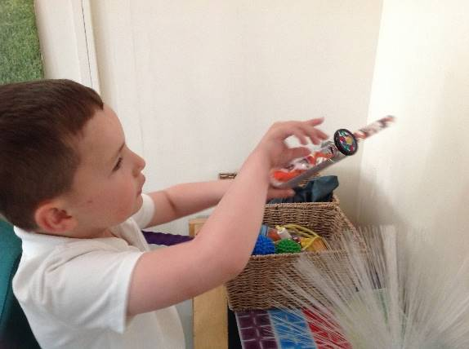
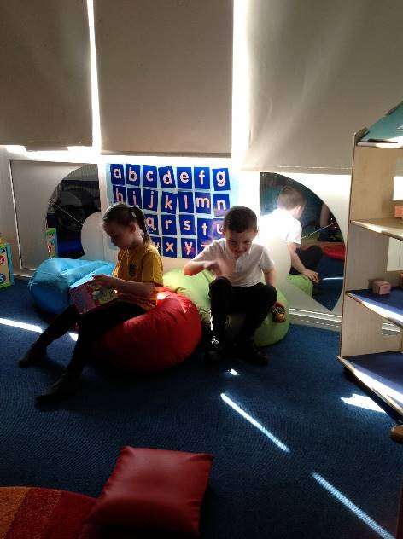
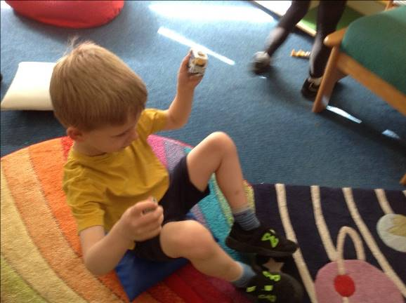
Accessing the sensory room

Slide 10
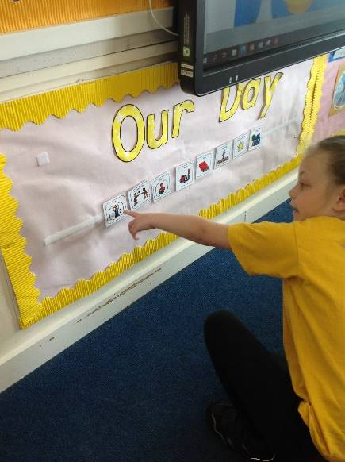
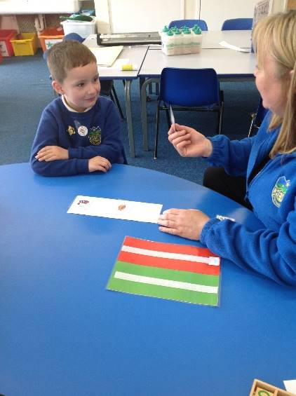
Use of the visual timetable & individual timetables

Slide 11
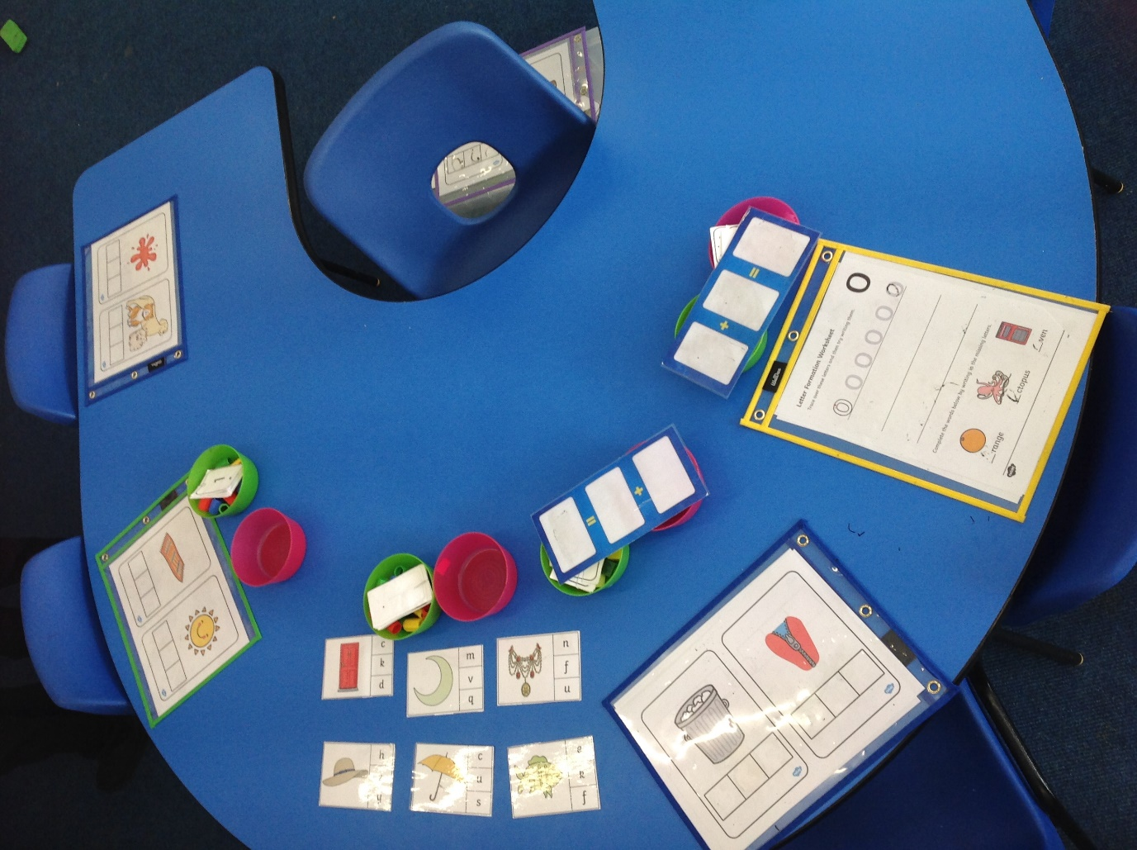
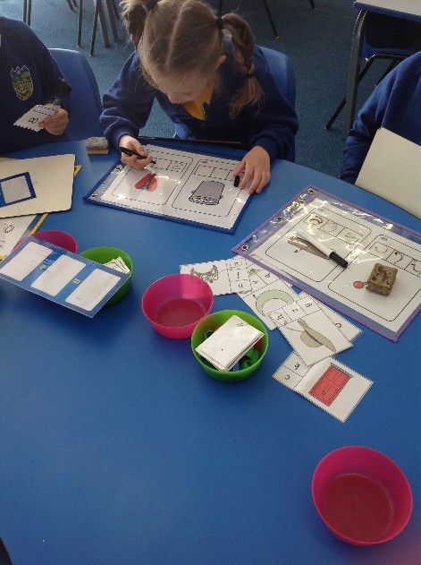
Morning starters to settle the children

Slide 12
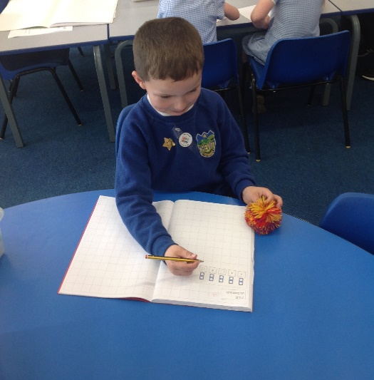
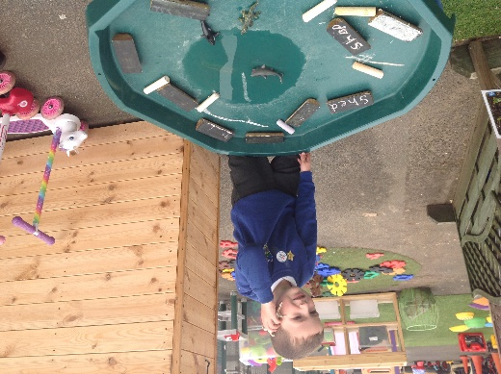
Practical/ chunked lessons using concrete or visual aids

Slide 13
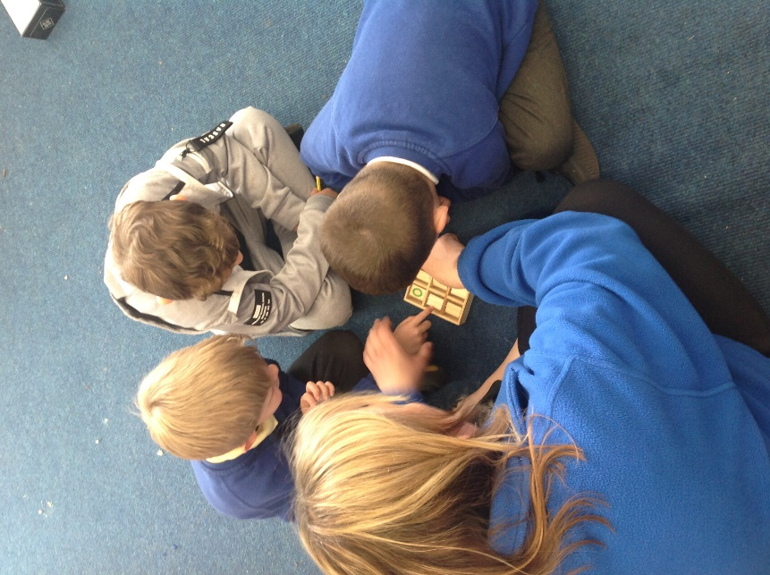
Social skills - sharing, taking turn games

Slide 14
Impact
The success of the advice and support put in place has enabled the children to remain calm throughout the school day – there are still times when they may have an emotional melt down but have a calm space to access to reduce anxiety.
The children are learning to play with function and positively interact with each other.
The children rely on the visual timetable & individual ones without this they are unable to cope with any minor change.

Slide 15
The class trip to the seaside was a success for all the children (first educational trip since they started school). All coped extremely well, accepted the additional support and changes to their daily routine.

